Slide 1
Proceed with caution
Electricity  Natural gas
How to be a Safety Superstar

Slide 2
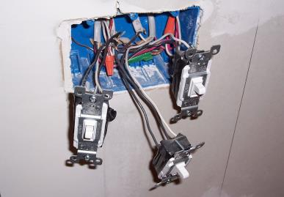
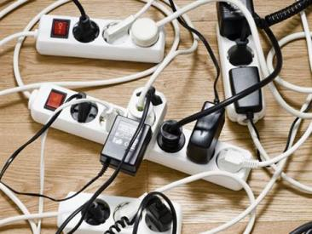
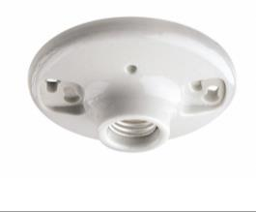
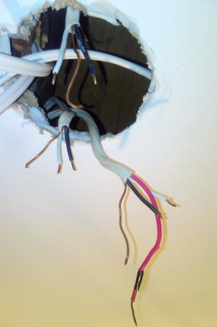
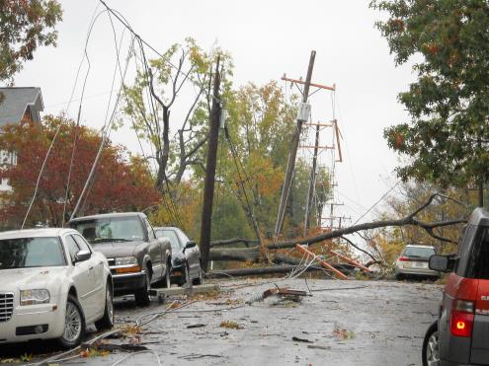
Shocking?
Notes:
Setting the Stage (1 slide: 3 – 5 minutes)
Have this slide on display as students enter the classroom. If that’s not possible, be sure to leave it up for at least 30 seconds before introducing the activity.
Ask students to speculate on what the images have in common. Once they’ve had the chance to think about it, ask a few students to share how they think the images relate to one another. (If they struggle, point to the title of the slide as a hint.)
Once you reach the point where students agree that the images depict risks associated with electricity/electrical hazards, ask for a show of hands from those who know very little about electric hazards and electrocution, then from those who know a few things about electric hazards and electrocution, then finally from those who think they know a lot about electric hazards and electrocution.
Let students know that you’re going to give them the chance to test themselves to see how much they know.

Slide 3
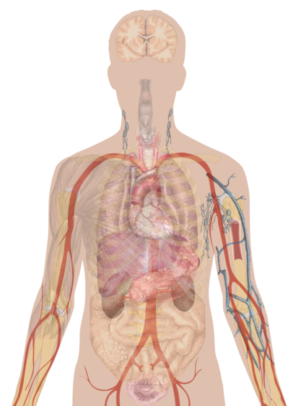
Shocking?
An electric conductor is a substance that allows an electric current to flow through it. An insulator limits or completely stops the flow of an electric current. Is the human body a conductor or an insulator?
Our bodies are conductors.
Our bodies are insulators.
A little of both: Substances in our bodies, like water, are conductors, but our skin acts as an insulator to a point, depending on the severity of the electric shock.
Notes:
Probing Prior Knowledge: Multiple Choice Quiz (8 slides, 15 – 20 minutes) CORRECT ANWER IS C. It’s such a different answer choice that students may pick it for that reason. It is important to emphasize that the human body is NOT an insulator, though it doesn’t conduct electricity to the same degree that metal might. Plus, because skin can act as an insulator, it can provide some protection from low-level electric shocks. What also affects the damage and the degree of conductivity/insulation is the path that the current travels in the body. [More in subsequent questions]
Decide how you want to solicit answers for the following quiz questions and let students know your expectations.
Spend an appropriate amount of time exploring and presenting the answer so that students understand that an electric current will flow through their bodies under many circumstances.

Slide 4
Shocking?
An electric shock occurs when a person comes in contact with an energy or electricity source, sending an electrical current into and through that person’s body. Which of the following can be the result of an electric shock?
Brain injuries, primarily affecting the nervous system
Heartbeat interruption, sometimes cardiac arrest
Burns
All of the above
Notes:
CORRECT ANSWER IS D. (2 of 8 slides)
Students are likely to get this correct, even if they didn’t realize that all of those different injuries can occur.
Before going over this question, ask students if any of them have experienced an electric shock before and what it was like. Many may talk about a shock from static electricity. (You can share that you’ll be doing some experiments with static electricity later.) Some may have felt a low buzz/zap from an electric current. Some may have even had a more severe experience. You can introduce the question by saying that sometimes the effect of an electric shock can be a lot worse than what they have experienced.
Ask the question. After revealing the answer, make sure that students know that cardiac arrest means that the heart stops beating.

Slide 5
Shocking?
True or false? Wet skin has significantly less resistance to an electric current than dry skin.
True
Notes:
CORRRECT ANSWER IS TRUE. (3 of 8 slides)
As mentioned in a previous question, up to a point skin can act as a bit of an insulator — a protective layer that provides resistance to an electric current. Wet skin, however, is more like a conductor. Students will mostly likely answer this correctly. Many probably will have heard about dangers of electricity and water. They probably weren’t sure why, though.
After revealing the answer, ask students if they’ve heard about the dangers water and electricity. Then ask those who have, if they knew why water poses an added danger.

Slide 6
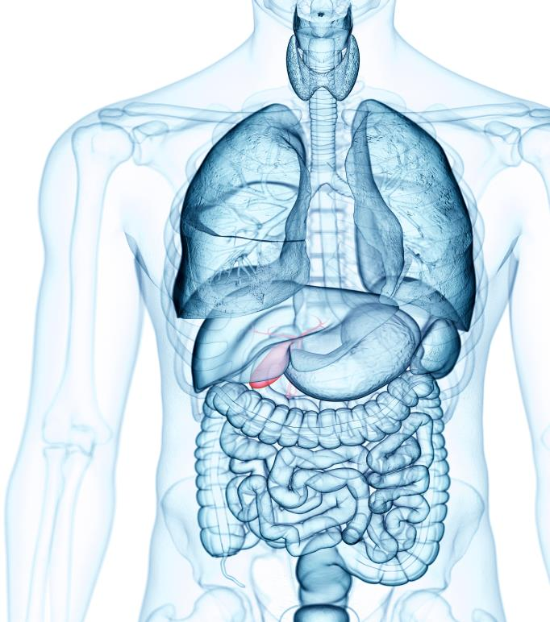
Shocking?
True or false? An electric shock can burn a person internally, causing damage to tissues and organs below the skin.
True
Burns from electric shock usually affect internal tissues and organs.
Notes:
CORRRECT ANSWER IS TRUE. (4 of 8 slides)
In fact, it’s more common that burns from electric shock affect internal tissues and organs, sometimes making it difficult to fully diagnose. Internal burning tends to reflect the path of the electric current through the body.
Before you reveal the answer, make sure that students have at least some understanding of what an internal or “subdermal” burn might mean: such concentrated heat and energy that it causes the body to burn from the inside. You’re likely to get a strong reaction of “that’s nasty” and the like!

Slide 7
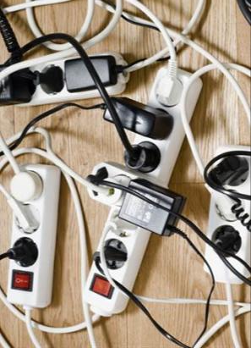
Shocking?
Electricity travels in circuits — think about the flow from an outlet to a cord to an electronic device.
True or false? A shock occurs when a person’s body becomes part of that circuit.
Each of these scenarios can create a shock:
Both wires of an electric circuit come in contact with the body.
One wire of an energized circuit comes in contact with the body, and the body is in contact with the ground.
A metal object or other conductor is energized and retains an electric current and comes in contact with the body.
True
Notes:
CORRECT ANSWER IS TRUE (5 of 8 slides)
All of these circumstances account for ways (outside of lightning) that people can be shocked, sometimes fatally. A) can often occur at home or in the workplace where there might be some DIY wiring or a severed wire that’s still slightly attached, and a finger touches the severed part. B) can also occur with a wire that’s completely severed or even with a downed power line. Students can picture C) as something like sticking a fork (metal conductor) into an outlet.
Of the questions, this is one that is most likely to require you to read it twice to ensure that people understand it. They’re likely to think that the answer is True but may not fully understand what it’s asking at first.
When you reveal the answer, you can say that these circumstances account for shocks (including static electricity for C) other than lightning.
Identify hazards to avoid — exposed wires and downed power lines, in particular.

Slide 8
Shocking?
Amperes (better known as Amps) are a measure of electricity flow. On average, a TV uses between 1 and 1.5 amps. On average, what’s the minimum number of amps that will cause a painful shock and some loss of muscle control?
.01 amps
1 amp
10 amps
Notes:
CORRECT ANSWER IS A. (6 of 8 slides)
According to Occupational Safety & Health Administration, direct exposure to anywhere between 6 and 30 millamperes (mA) is likely to cause a painful shock and loss of muscle control, including “freezing” — where muscles tense up and can’t let go of the source of the electric current.
If necessary, provide a little more context to “amps” by using the hyperlink in the question to take you to the term’s definition in the glossary. Students should recognize that it’s a measure of the rate of electricity flow and that many household appliances tend to use between 1 and 5 amps. [I’D LIKE THIS TO BE AS ACCURATE AS POSSIBLE BUT ALSO TANGIBLE.]
When you reveal the answer, help make sure that students recognize that a TV uses 100 times more amps than is required to cause a painful shock.

Slide 9
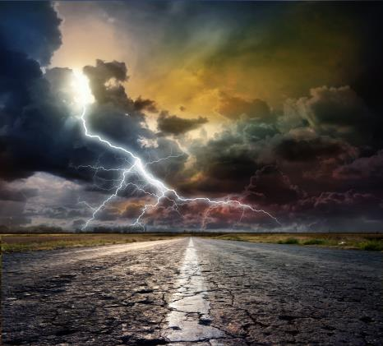
Shocking?
True or false? Each year, lightning kills roughly the same number of people in the U.S. as electrical accidents.
False
Annual U.S. deaths from lightning strikes: ~50
Annual U.S. deaths from electrocutions: ~400
Notes:
CORRECT ANSWER IS FALSE (47 of 8 slides)
Annual deaths from lightning strikes average 50 a year in the U.S., while annual deaths from electrocutions average nearly 400. In other words, roughly 8 times more people die from electrical hazards than from lightning.
Before you reveal the answer, ask some students to speculate on how many people they think die each year from lightning and from electrical accidents.
Reveal the answer and the average annual deaths. Explore if the numbers are surprising and if so, why/how.

Slide 10
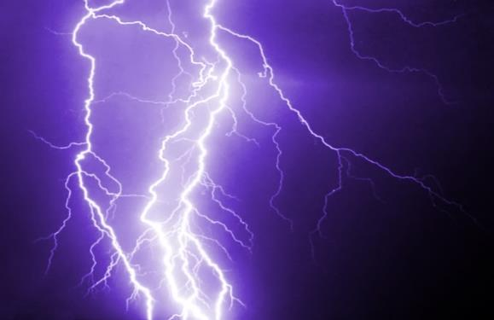
Shocking?
Both have “leaping” electrons!
Lightning is a form of static electricity.
True or false?
True
Notes:
TRANSITIONING TO STATIC ELECTRICITY (8 of 8 slides: 3 – 5 minutes for this slide)
CORRECT ANSWER IS TRUE.
[The next slide provides more information on static electricity.] A bolt of lightning is a form of static electricity. It shares qualities with the phenomena that causes hair to stick to a balloon. Electrons leap from one object to another — sometimes within the same cloud, sometimes between two clouds and sometimes between a cloud and the ground (a lightning strike).
You can let students know that this is the last question. Before asking students to indicate their answers, pass out inflated balloons or balloons for students to inflate quickly and tie off.
While you distribute the balloons, have a student or two try to provide a working definition of “static electricity” — a concept you may have previously explored in the quiz.
Have students in pairs, small groups (depending on the number of balloons), create friction between two balloons and someone’s hair and then slowly lift the balloons away from the head to create the effect shown in the image. You can have them take turns or simply do it one time. If they take turns, encourage them to experiment with the amount of time they create friction, how quickly they rub the baloons, etc., to see if it changes the perceived amount of static electricity.
Reveal the answer, acknowledging that a majority were correct or mistaken that lightning is related to a balloon causing hair to stick up! Then share that you will learn more about static electricity as a way to better understand electricity.

Slide 11
Show whatcha know …
Elaborate on the points below.
Conductors promote the flow of electricity
Insulators limit or stop the flow of electricity
Electric shock occurs when your body comes in contact with an exposed electric circuit
A painful shock can result from even a low level of amps
Exposure to an electric shock can cause serious harm, including death
Notes:
Transition Into Next Activity (1 slide: 3 – 5 minutes)
This slide is a transition into the next area of focus.
One at a time, have different students expand upon each bullet as a way to review the key points up until this point.

Slide 12
Static? But … negative charges move!
static: lacking movement
static electricity: a stationary electric charge built up on a substance
static electric shock: the occurrence when electrons leap from one object to another
Notes:
Delving Into Static Electricity (1 of 3 slides: 3 – 4 minutes)
Ask students to try to explain what happens with static electricity based on the definitions on the slide. Prompt them to think about experiences where they actually feel a shock from static electricity — often when it’s cold, they might rub their feet on a carpet and then touch someone or something. You’re looking for something along the lines of friction creates a “charge” when electrons move from one object to another — when there are many electrons that move from one to another it creates a spark or a shock or a lightning bolt. They may even know that a positively charged object is attracted to a negatively/neutrally charged object (and vice versa). The balloon is negatively charged (more electrons than protons), and the hair is positively charged (more protons than electrons).
When they have provided an explanation that is close (or when they demonstrate that they really don’t know), advance to the next slide.

Slide 13
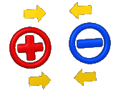
Static? But … negative charges move!
Notes:
Electron Movement (2 of 3 slides: 2 – 3 minutes)
Reinforce that electrons jump when two objects rub together (friction).
Also reinforce that the number of electrons in an atom relative to its protons determines if it’s positive (more protons), negative (more electrons) or neutral (same numbers of each).
That “opposites” attract. Positive-to-positive or negative-to-negative are the only situations where they don’t attract. Balloon is negative, and hair is positive.

Slide 14
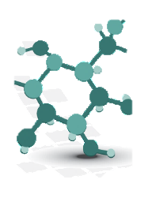
Static? But … negative charges move!
Can you name the order of events that leads to an electric shock? Shocking if you can’t get these in the correct sequence!
Electrons spread around your body, and you get a negative charge.
You encounter an object that is neutrally or positively charged, and the electrons make the jump.
You keep picking up electrons from the friction on the floor, until…
Slide feet on carpet, electrons go from carpet to your shoes/socks/body.
Notes:
Static Shock Sequence (3 of 3 slides: 2 – 4 minutes)
Correct order is: 4, 1, 3, 2.
Ask students to determine the correct sequence of events that results in a shock. (It should not be very difficult, but it should be a way to keep them more engaged and to help them process the sequence.)

Slide 15
Show whatcha know …
Elaborate on the points below.
Electrons jump from one atom to another
Loss or gain of electrons determines the charge of an atom
“Opposites” attract
Notes:
Transition Into Next Activity (1 slide: 2 – 4 minutes)
This slide is a transition into the next area of focus.
One at a time, have different students expand upon each bullet as a way to review the key points up until this point.

Slide 16
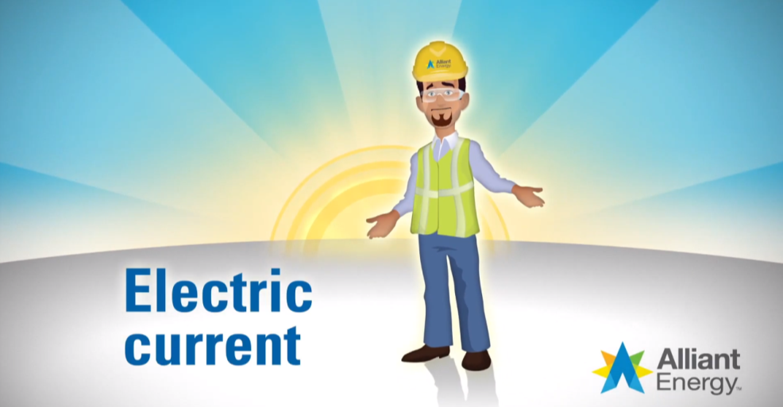
Negative charges move … in circuits!
Notes:
Defining Electric Current (1 slide: 5 – 8 minutes)
Before showing the definition of “electric current,” ask students how the electricity we use every day differs from the static electricity from the balloon. (They may not have any idea, or they may already know a lot.) Use their explanations as frames of reference — e.g., they may focus on how it’s used differently, how it’s produced and/or how it’s controlled.
Show the definition: https://www.youtube.com/watch?v=tvWeHtqFId8
Ask a few students to share something that they learned from the definition.
Watch the definition again.
Ask students to write down at least two questions that they have about electric currents. Stay on this slide.
Have students share some of their questions. Facilitate that conversation so that there are no “dumb” questions, and probe a bit on why they are interested in some of the questions that they have identified. Let the amount of time you have and the level of participation dictate how many questions you have students share with the class.

Slide 17
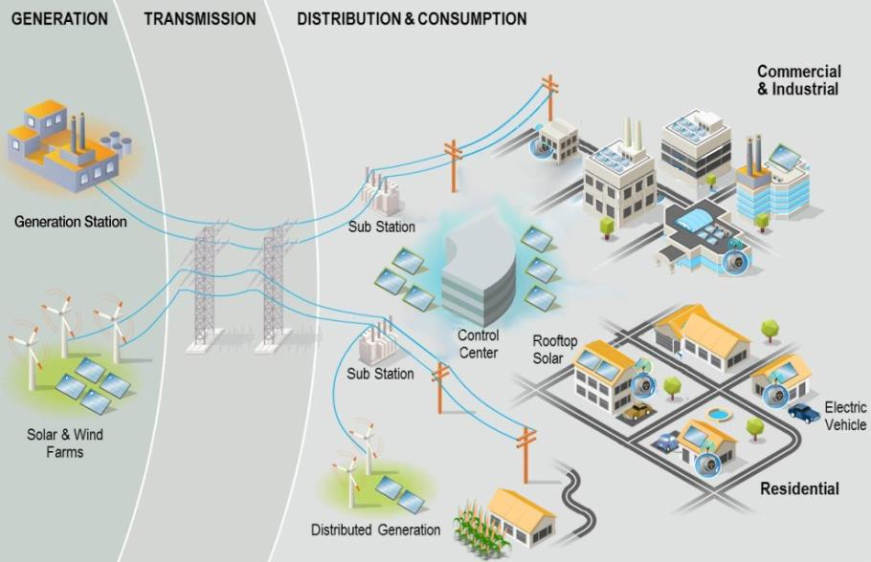
How electricity moves to your home
Notes:
Electricity Generation and Movement (1 slide: 4 – 6 minutes)
This illustration provides a visual reference for the process for getting electric currents from the generation station to homes and businesses that use the electricity. With the help of the illustration, have a student or a few students describe the process of how electricity moves from the generation station to our homes. Encourage students to include the subatomic actions of electrons in their description.
Note that wires aren’t just overhead: we also install them underground. Underground wires reduce power outages and keep neighborhoods prettier and safer.

Slide 18
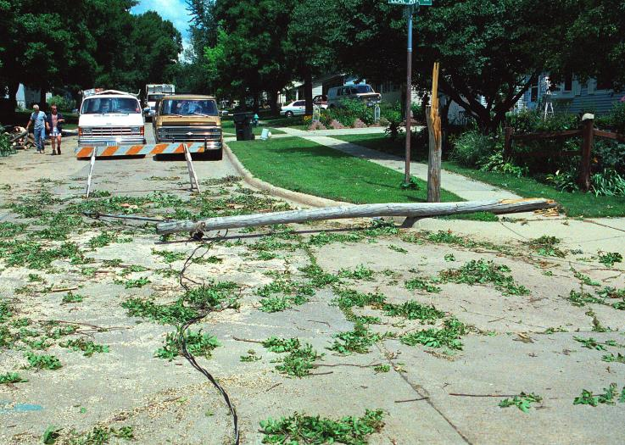
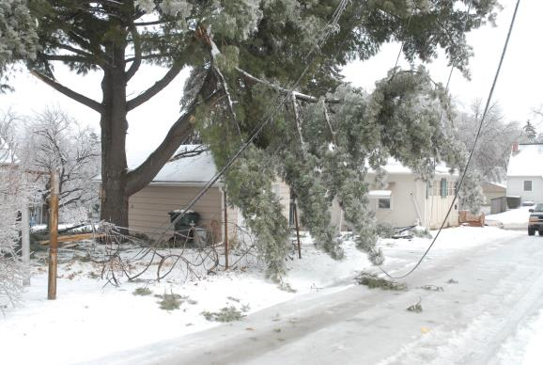
The danger of a downed line
Notes:
The danger of a downed power line (1 slide: 2 minutes)
Storms and wind can damage power lines and cause them to fall. This is what we call a “downed line.”
A downed line is extremely dangerous. When a line falls to the ground, electricity doesn’t stop flowing through it. Chances are good it is still energized, and it will also energize the objects around it. This includes cars, tree branches and anything else nearby.
Never touch or go near downed lines – and in you’re in a car, don’t drive over one. Stay back and call 911.
If you have time, this longer video (5:21) does a great job illustrating what to do if you’re in a car and contact a power line: https://www.youtube.com/watch?v=fLVzvMTgGDY

Slide 19
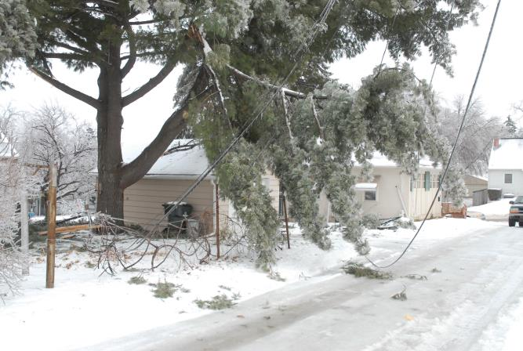
What’s wrong with this situation?
Notes:
What’s wrong with this situation? (1 of 3 slides: 5-10 minutes total)
These slides conclude the electric safety section. Now, students should better understand why and how electricity can be dangerous.
With the help of the images, have students highlight some of the dangers and the reasons they’re dangerous.
[Photos left to right]
Downed power line: You should assume that any power line you see is energized and dangerous. Don’t go near downed lines – and in you’re in a car, don’t drive over one. Stay back and call 911.
Water and electricity don’t mix. The bathroom might be the most dangerous room in your house, electrically speaking. Your body is a good conductor – especially if your skin is wet. This is why you should never use electrical appliances, like a hair dryer or a plugged-in razor, while in the tub or standing in water. After you wash your hands, dry them thoroughly before touching the light switch to turn off the light.

Slide 20
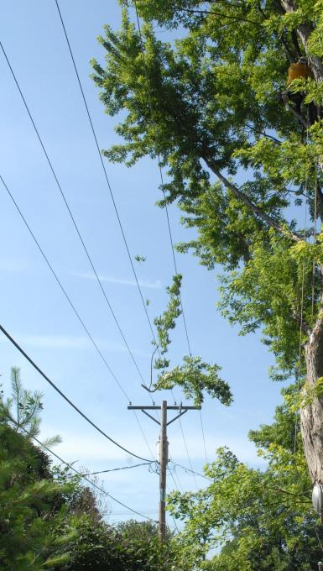
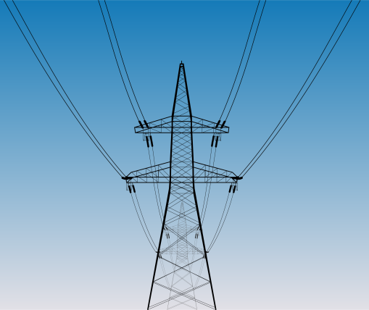
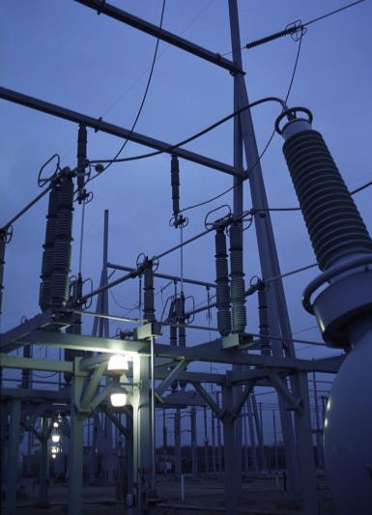
What’s wrong with this situation?
Notes:
What’s wrong with this situation? (2 of 3 slides: 5-10 minutes total)
[Photos left to right]
Kites – Never fly a kite near power lines or other electrical equipment, like substations (purple image). If the kite contacts the lines, the electricity could come down the string and you could get shocked. If your kite is heading toward wires, just let go. If it gets tangled in the lines, call Alliant Energy and we’ll get it for you.
Drones – Keep your drone away from electrical equipment, both power lines and substations. If it contacts equipment, it could cause an outage or even a downed power line. If your drone or kite goes into a substation area, don’t go in after it. Call Alliant Energy, and they’ll get it out.
Trees fallen on or growing into power line – It’s a serious situation when a tree grows into a power line. When you climb a tree, look up to make sure there are no wires running through it. Also: If you see something caught in a powerline (like the branches in this photo), don’t try to get it out. Call Alliant Energy.

Slide 21
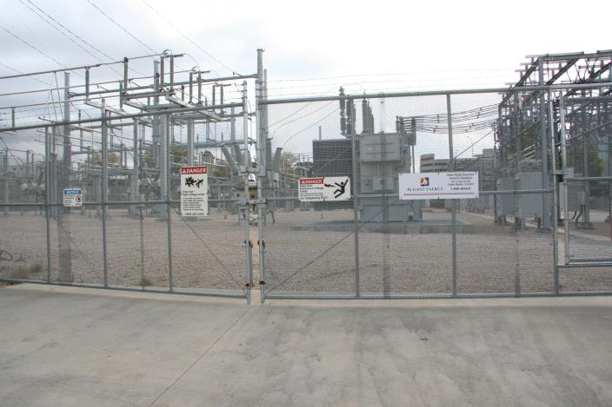
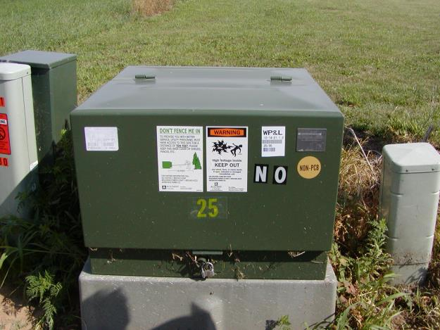
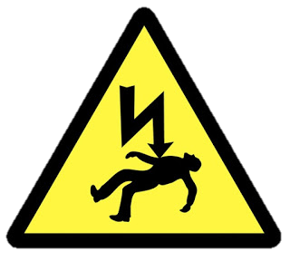
What’s wrong with this situation?
Notes:
What’s wrong with this situation? (3 of 3 slides: 5-10 minutes total)
[Photos from left to right]
This fenced-in area is called a substation. The electricity used in substations is extremely dangerous and can kill a person. The signs on the fence say “Danger” and “Warning: High voltage.” Stay back away from the fence. If your ball or even your pet gets inside, don’t go in after it. Call Alliant Energy immediately to come get it out.
Green boxes like these are called pad mount equipment, because they sit on top of a concrete pad. The job of the boxes is to protect the high-voltage components inside. Don’t try to open a box or climb on one. If you ever see one of the boxes damaged or unlocked, report it to Alliant Energy.

Slide 22
What about natural gas?
Notes:
Defining Natural Gas (1 slide: 5 – 8 minutes)
Before showing the definition of “natural gas,” ask students if they know how their water is heated. Many will likely know that they have a water heater (maybe two!) — some may have experienced “running out of hot water.” Ask if they know what energy source heats the water. You don’t need to spend too much time on this. It is likely gas or electric, and perhaps some have a solar-powered water heater.
Ask how they boil water to make pasta — what energy source heats the water?
Play the definition video: https://youtu.be/LpJO2J5h1XA
Ask a few students to share something that they learned from the definition.
Watch the definition again.
Ask about what questions students have.
Have students share some of their questions. Facilitate that conversation so that there are no “dumb” questions, and probe a bit on why they are interested in some of the questions that they have identified. Let the amount of time you have and the level of participation dictate how many questions you have students share with the class.

Slide 23
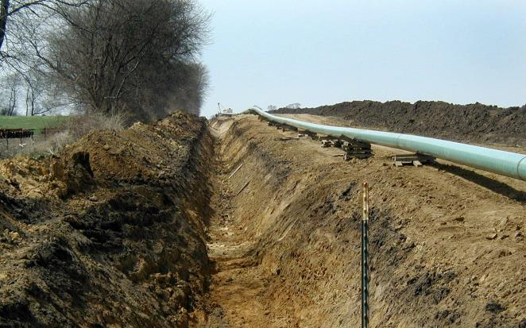
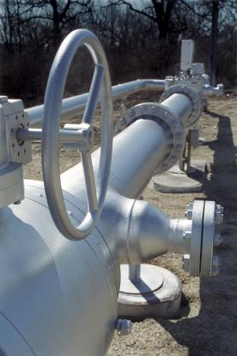
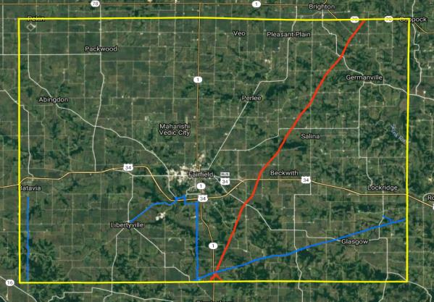
Natural gas travels through pipes
Natural gas travels to your home through a network of underground pipes, which are owned by energy companies.
Notes:
Natural Gas piped underground (1 slide: 4 – 6 minutes)
This slide includes a screenshot from a government website that allows you to see satellite images of geographic areas with the main natural gas network highlighted in those areas. For this section, you can enter information for your county and see the extent of the network of natural gas pipelines as well as the pipes’ locations. https://pvnpms.phmsa.dot.gov/PublicViewer
Ask students to describe the shape of the county the school is in. Ask them if they know the approximate size (in area) of the county. [You’ll need to look this up, if you ask this question!] You can also ask them for the names of the cities and towns in the county. All of these questions are meant to help make the county more tangible to students — a way for them to quantify and qualify it.
Enter the county name on the website and reveal the satellite image of the county with its network of the main natural gas arteries. The default settings for the website are to show the Gas Transmission Pipelines in blue and the Hazardous Liquid Pipelines in red.
Give students some time to absorb what the map displays by zooming in and/or moving around within the county. You can try to zoom in and find your school.
Ask students to explain what the map depicts. It’s important that they recognize that the pipelines depicted are the mainlines that feed into the system that pipes natural gas to homes. (It should be obvious that the map does NOT depict the intricate network of residential/neighborhood pipes.)
Ask students to describe what they think the map would look like if it depicted the entire network of natural gas pipes, including those that go to individual homes. They should say something to the effect of the map being very busy/full/complicated with many lines going in many directions.

Slide 24
Natural gas travels through pipes
Notes:
Call Before You Dig (2 slides: 5 minutes)
Ask students to fill in the blanks. When you have serious emergency, you call ___ Before you dig deeper than one foot, you call ___. [911, 811] This should be easy because of the image on the screen!
Ask students why they think it’s important to call 811 before digging. By now, they should recognize that there is an underground network of natural gas pipes that they don’t want to dig into, which can cause a leak. Note to students that other important utilities are also buried underground, including water and electric lines. The little colored flags you see in the ground, or patches of painted ground, are there because someone has come and marked the locations of the utilities underground – so don’t move them. And, before your parents dig at home, have them call 811 so that the locations of these utilities can be marked in your yard as well.
Play the video, which further illustrates why it’s important to call before you dig: https://youtu.be/nHkZXwjIQKQ

Slide 25
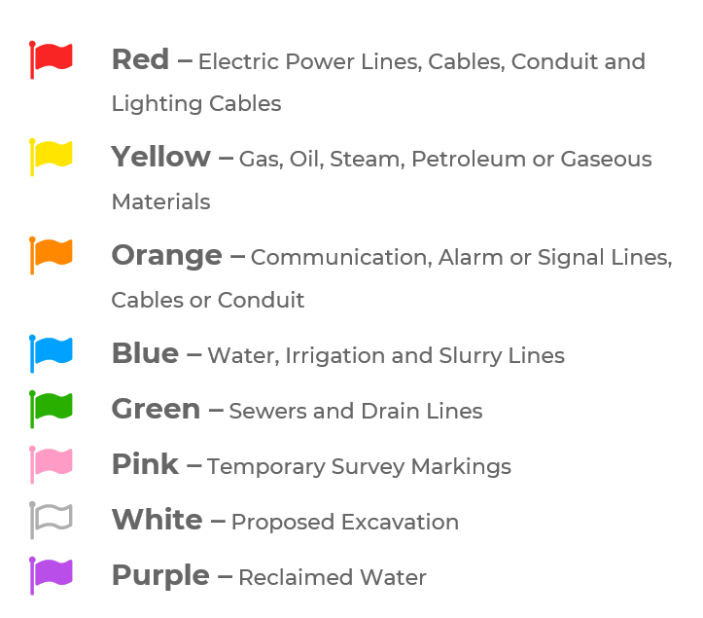
What do the flags mean?
Notes:
Call Before You Dig (2 slides: 5 minutes)
The girl in the video on the previous slide mentioned dangerous things buried underground. Often these are marked with a flag like the one on this slide. See the key to understand what the flags’ colors mean.

Slide 26
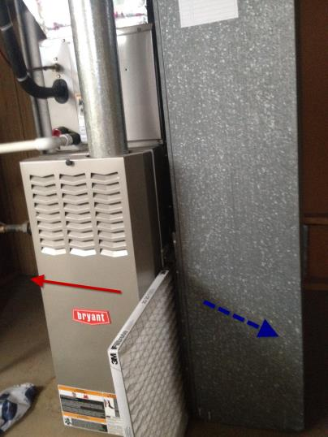
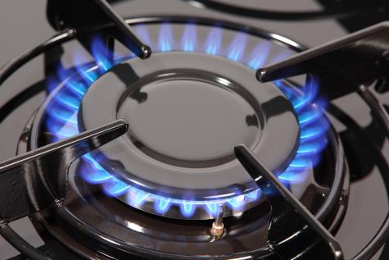
You can’t see gas… but you can smell it!
Why add another gas (Mercaptan) to the gas?
Notes:
Why Mercaptan Is Added (1 slide: 4 – 6 minutes)
Ask students why companies like Alliant Energy add a gas that smells like rotten eggs to natural gas. Students should arrive at the idea that it helps people detect leaks.
Make sure to explore why it’s important that people are able to detect leaks. In a gas leak situation, there’s danger of fire and explosion — natural gas is highly flammable.
Ask students what they think you should do if you detect a leak. (It’s mentioned in the definition of natural gas.) Leave the home, get to a safe distance, and call 911.

Slide 27
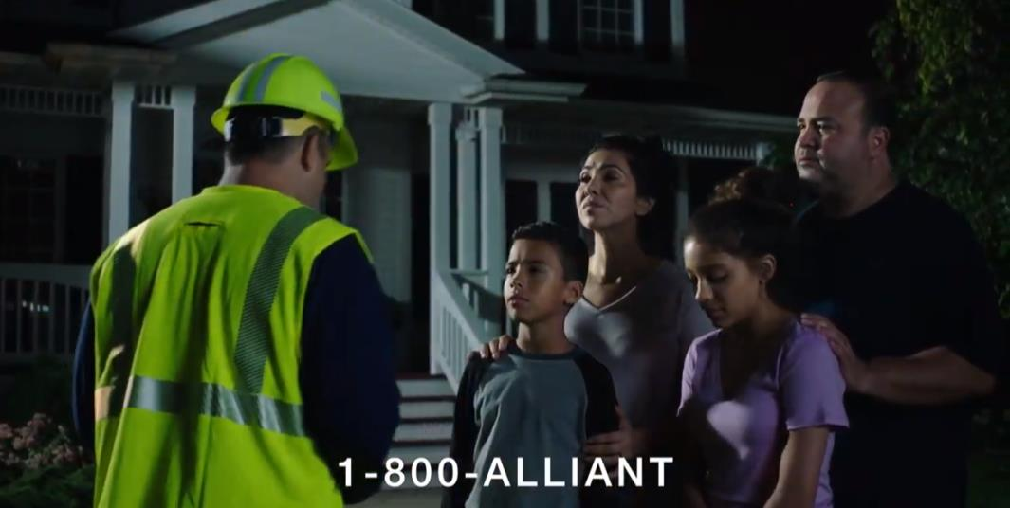
Smell gas? Move fast.
Notes:
Smell gas? Move fast. (1 slide: 2 minutes)
This video illustrates what to do if you smell natural gas: https://www.youtube.com/watch?v=lN41IOBE9U4

Slide 28
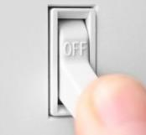
If you think you smell natural gas …
DO
DON’T
Tell an adult.
Get out of the area quickly.
Call Alliant Energy after you’re out of the area.
Use your phone, flip light switches, or use the garage door opener – it could cause a spark.
Notes:
What to do if you smell gas (1 slide: 3 - 4 minutes)
Students should have a general idea of what to do if they smell gas, from watching the video on the previous slide.
Review the cautions in the “Don’t” column, which the video did not cover. Since natural gas is flammable, you should avoid doing these things as you make your escape. You don’t want to cause a spark.

Slide 29
The silent killer: Carbon monoxide
Notes:
The silent killer (1 of 2 slides - 5 min total)
This video explains what carbon monoxide is, and the symptoms of poisoning: https://www.youtube.com/watch?v=2HiXj6tvkBY&feature=youtu.be
Help students understand that natural gas and carbon monoxide are NOT the same thing.
Carbon monoxide is a byproduct of natural gas. Usually, it’s not a problem: it gets burned up along with the gas in your stove, furnace, water heater, etc.
Appliance malfunction, though, can cause incomplete combustion, so that carbon monoxide gets into the air you breathe.
Carbon monoxide poisons you by restricting the amount of oxygen in your blood.
Affects of carbon monoxide poisoning are kind of like the flu: nausea, dizziness, vomiting, headache, drowsiness – and in high concentrations, confusion, coma and death.

Slide 30
3 Ways to catch the killer
Get a carbon monoxide detector!
In the winter, keep the vents around your house clear of snow and ice.
Get your appliances checked by a professional every year.
Notes:
The silent killer (2 of 2 slides - 5 min total)
Have one student read each of the top three tips. The carbon monoxide detector is the biggest one, and probably the most relevant to students themselves (vs. parents).
Already have a carbon monoxide detector? Go check its batteries and / or make sure it’s working.
More is better: Just like you have several smoke alarms throughout your house, put carbon monoxide detectors in all major areas of your home.
Carbon monoxide especially loves to catch people asleep, when you’re not able to realize how it’s affecting you. So the most important place to put your detector is near your family’s bedrooms, or anywhere people sleep.

Slide 31
Show whatcha know…
Elaborate on the points below.
Natural gas travels through a network of pipes – much of it underground
Natural gas can be burned to produce heat
A stinky odor is added to natural gas
Natural gas leaks can cause fires and explosions
Always call 811 before you dig
A malfunctioning gas appliance can produce carbon monoxide
Notes:
One at a time, have different students expand upon each bullet as a way to review the key points up until this point.

Slide 32
Your turn to spread the word!
In your group, make a list of safety Do’s & Don’ts for electricity and natural gas.
All of the items on your list are important, but put them in order of priority — what are the most important messages on your list?
Imagine you need to teach your highest priorities to younger kids.
How can you reach them? What will get their attention?
Create a list of strategies to reach and teach kids in elementary school.
Choose four or more of your messages and at least two strategies. Then – go bring them to life!
Notes:
Student Group Projects (1 slide: 30 – 50 minutes)
Decide the amount of time that you want to spend on this portion of the module as well as the resources you are able to provide for creating educational materials. The primary outcomes are for your students to create educational materials (e.g., posters, PSAs, school announcements) on energy safety for elementary school children. If possible, it will be a valuable experience for students to visit a younger class and teach what they have learned. This slide will guide them through the process, but you will have to provide your specific expectations.
Reveal each step as you get there.
Divide students into groups (2 – 4 students per group). Go over Step 1. Set time frames, answer questions, etc.
Reveal step 2. Set time frames, etc.
Reveal step 3 and its bullets. It may be best to facilitate the first part as a full class.
Reveal step 4 and let the students loose to create their own resources.

Slide 33
You are now a Safety Superstar

